Slide 1
Networking: keeping you connected to THE things that matter

Slide 2
We use the internet for:
Research
Education
Shopping
Phone Calls
Instant Messaging
Meetings
GPS
Gaming
Tech Camp today

Slide 3
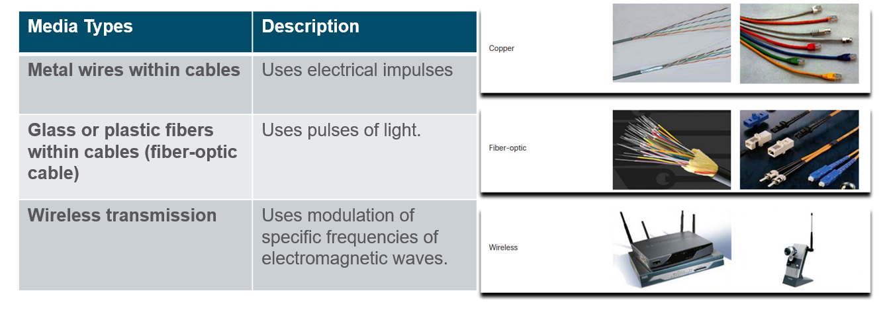
Network media

Slide 4
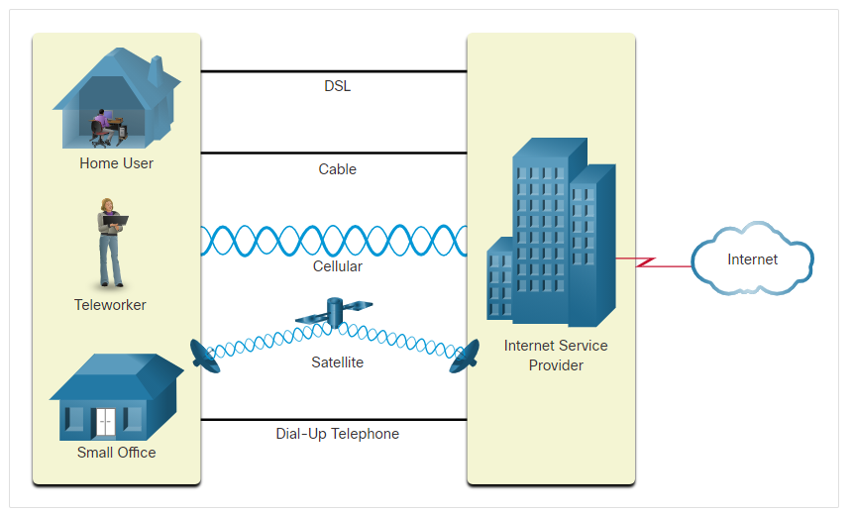
Connecting to a web site
Notes:
I dismiss the topic of climate change since “I am looking forward to having beachfront property in Winnipeg”

Slide 5
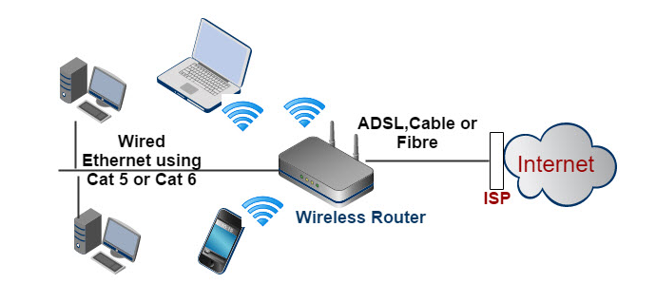
Typical home network setup
Notes:
I dismiss transhumanism saying most people in the room have probably never heard of it.

Slide 6
Importance of standards
We have seen that internet communication takes place in a variety of ways
This leads to the importance of standards in the networking world
In order to provide seamless communication, all networking media and the transmission of that communication follows protocols
Networking protocols can be defined as rules that govern the transmission of data

Slide 7
ACRONYM STEW
NAT
STP
DNS
EIGRP
UDP
IPv4
PAT
HTTP
DHCP
TCP
BGP
OSPF
OSPF
IPv6
RJ45
HTTPS
WiFi

Slide 8
ACRONYM STEW
NAT
STP
DNS
EIGRP
UDP
IPv4
PAT
DHCP
TCP
TCP
BGP
OSPF
OSPF
IPv6
RJ45
Wifi

Slide 9
Requirements for communication
In order to communicate between your device and any other device on the network three pieces of information are needed:
MAC address
Logical address – IPv4 or IPv6
Port number
We will explore each of these pieces of information and see how they work together to deliver information over the Internet

Slide 10
Many ways to determine the address of my device
Every device will have the required addresses for network communication
Depending upon your operating system and the access you are granted on the device, there are different ways to determine the address of your device
The following slides will demonstrate methods to find your address on different devices
Choose the method that matches both your operating system and the access you have to the device settings

Slide 11
Mac address
Your computer's Network Interface’s physical address.
Is like your name... stays the same even if you move to a different street.
"Burned in" by the manufacturer into the device. Unique for every device
Some operating systems are offering the option of randomizing your MAC address as a security feature
Displayed as a hexadecimal number
The MAC address is made up of 6 pairs of hexadecimal numbers separated by either a dash ('-') or a semi-colon (':')

Slide 12
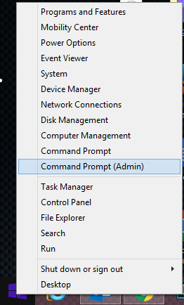
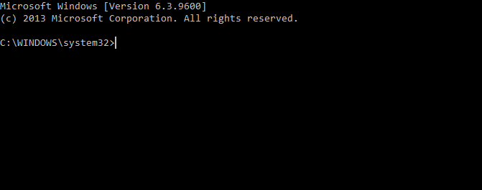
Windows 10 device with access to a command prompt
Right-click on your start-menu (lower left corner of your screen)
In the menu that pops up, left-click on Command Prompt (Admin). This will open a command prompt window (see below)
Type the command ipconfig /all to display the information

Slide 13
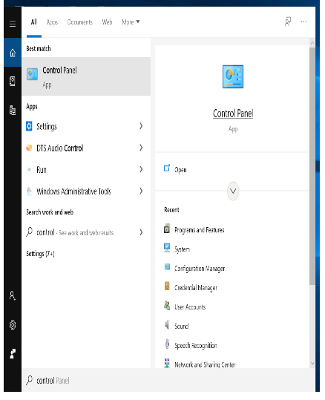
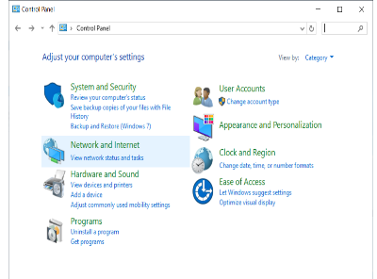
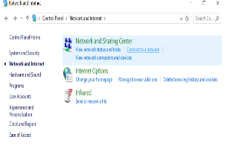
Windows 10 device with access to the control panel
Open the control panel app on your device by searching (you should type control)
Choose Network and Internet, Network Sharing Center
Highlight your connection method on the left-hand side. You will be able to choose to look at the properties from the right-hand side of the screen

Slide 14
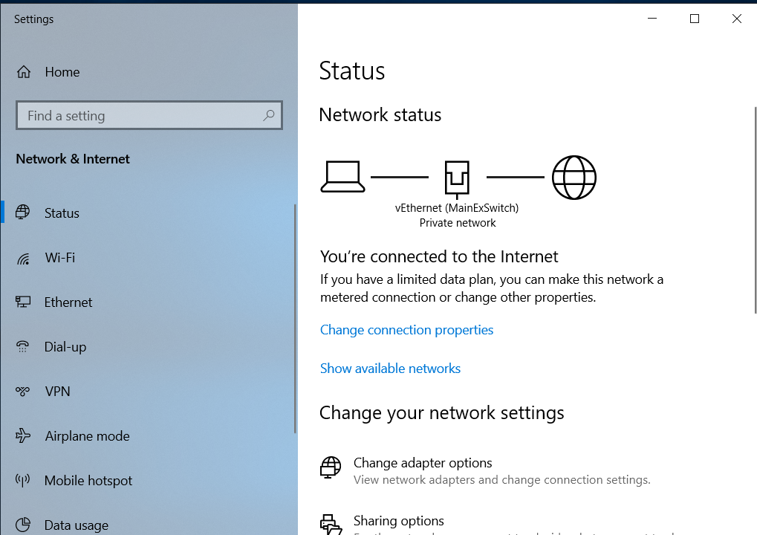
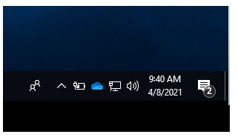
Windows 10 device with access to network settings on taskbar
Right-click the Network icon from the taskbar
Choose Open Network & Internet Settings
Highlight your connection method on the left-hand side. You will be able to choose to look at the properties from the right-hand side of the screen

Slide 15
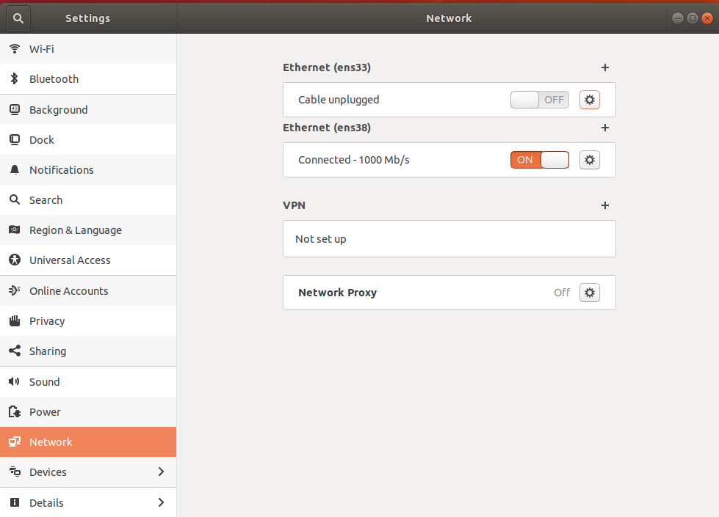
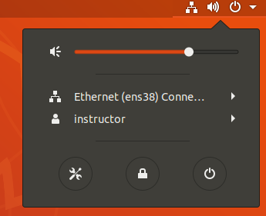
Linux device with access to a gui
Right-click the Network icon from the taskbar
Choose Wired or wireless Settings option under the network connector

Slide 16

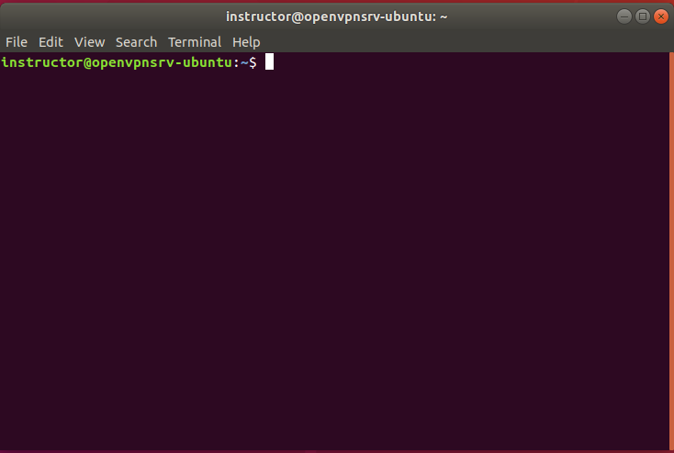
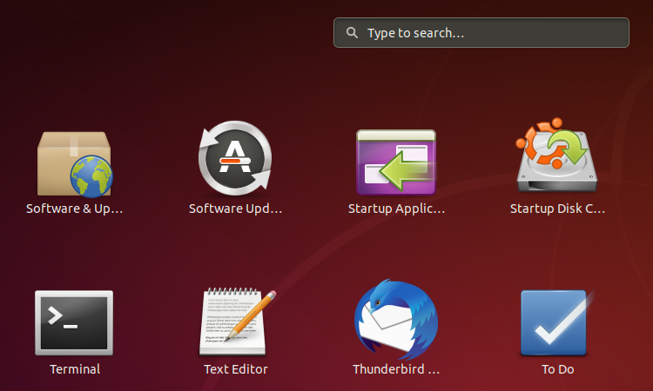
Linux device with access to Terminal
Click on your show applications menu (lower left corner of your screen)
In the menu that pops up, left-click on terminal. This will open a terminal window (see below)
Type ip addr to see your address information

Slide 17

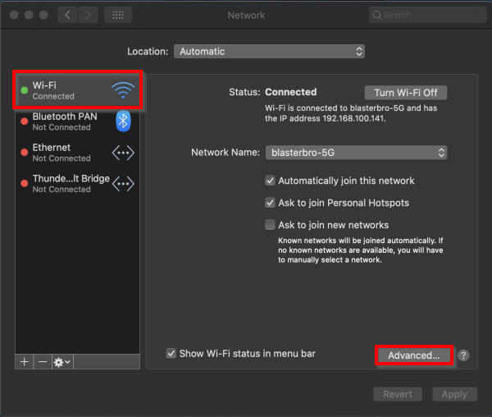
Mac OSX WITH ACCESS to A GUI
Left-click the Network icon from the top right taskbar ​
Choose Open Network Preferences... option at the bottom
Choose Wi-Fi (or Ethernet if hardwired) from the right-hand pane
Choose Advanced from the bottom right corner

Slide 18
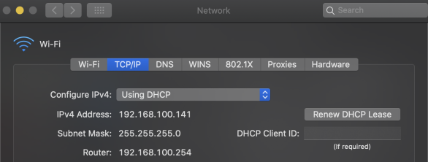
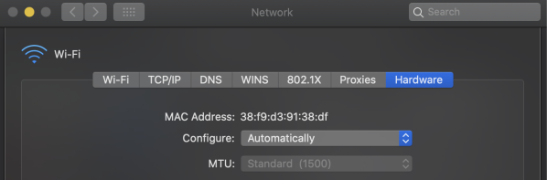
Mac OSX WITH ACCESS to A GUI
Choose TCP/IP from the top bar to view your IP settings
Choose Hardware to view your MAC address

Slide 19


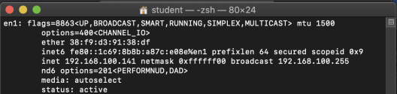
Mac OSX WITH ACCESS to TERMINAL
Left-click the Spotlight icon from the top right taskbar
Type Terminal and press enter
Type the command ifconfig and press enter
Locate your network interface (e.g. en1)
ether field is MAC address
inet is IPv4 address

Slide 20
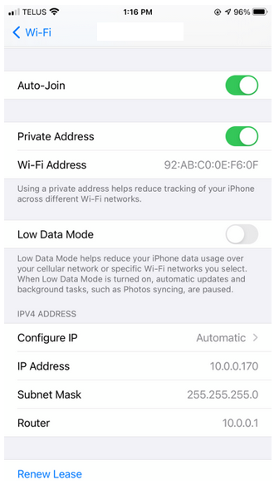
iphone with access to device settings
Choose Settings and then your WiFi network
Choose the Info button to see your device address information on that WiFi network

Slide 21
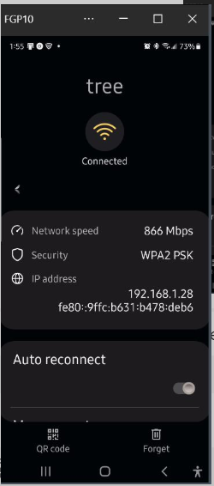
Android phone with access to device settings
Choose Settings, Connections and then your WiFi network
The address information on that WiFi network for this device will be shown

Slide 22
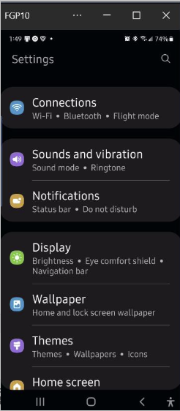
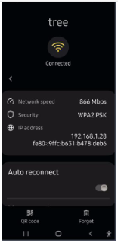
Android phone
Choose Settings, Connection and then your WiFi Network
Your settings will be displayed

Slide 23
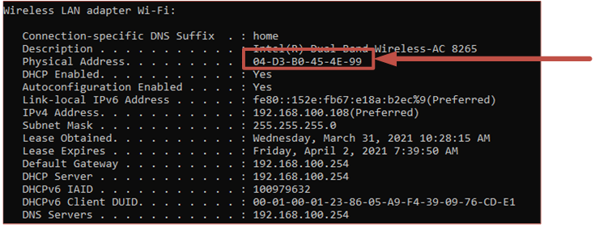
Finding your mac address
Type ipconfig/all at a command prompt

Slide 24
IP Addresses
Your computer’s Logical Address
Like a street address
Packets are sent addressed to a specific “house/host” which is located on a specific “street/network”
Routers read packets and send them in the direction toward the network the packet is addressed to

Slide 25
IPv4 and ipv6 addresses
IPversion4 is shown as 4 decimal numbers separated by "."
Each number is between 0-255
IPversion6 is shown as a hexadecimal numbers separated by ":"
Each group is 4 hexadecimal digits long and there are 8 groups total
IPv6 allows for many more addresses and is slowly being implemented and IPv4 will be phased out

Slide 26
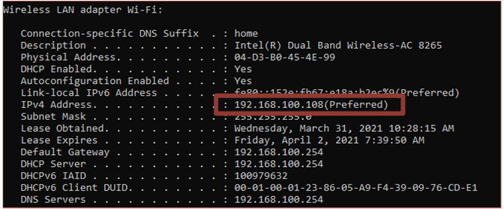
What’s my ipv4 address?
Look for an IPv4 address that is in the dotted decimal format (4 decimal numbers separated by ".")

Slide 27
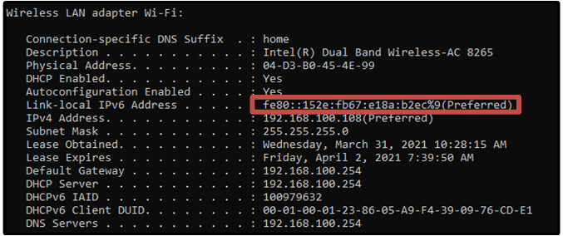
What’s my ipv6 address?
You should see your IPv6 address which will be displayed as a long hexadecimal number consisting of 8 groups of 4 hexadecimal digits

Slide 28



Routing – within Your Local Area Network (LAN)
Source IP Address: 10.18.35.2
Destination IP Address:
10.18.35.25
10.18.35.0 Street
Lot 2
Lot 25

Slide 29
Routing - outside your Local Area network
Source IP Address: 10.10.0.6
Destination IP Address:
192.168.2.254
10.10.1.0 Street
192.168.2.0 Street
Lot 254
10.10.0.0 Street
192.168.1.0 Street
Lot 6

Slide 30
Port number
Port number is used to identify different processes/services on your system
Different processes use different port numbers.
Port numbers help determine what protocol incoming packets should be directed to.

Slide 31
Well Known Port Numbers
Port Number | Protocol | Application
20 | TCP | File Transfer Protocol (FTP) - Data
21 | TCP | File Transfer Protocol (FTP) - Control
22 | TCP | Secure Shell (SSH)
23 | TCP | Telnet
25 | TCP | Simple Mail Transfer Protocol (SMTP)
53 | UDP, TCP | Domain Name Service (DNS)
67 | UDP | Dynamic Host Configuration Protocol (DHCP) - Server
68 | UDP | Dynamic Host Configuration Protocol - Client
69 | UDP | Trivial File Transfer Protocol (TFTP)
80 | TCP | Hypertext Transfer Protocol (HTTP)
110 | TCP | Post Office Protocol version 3 (POP3)
143 | TCP | Internet Message Access Protocol (IMAP)
161 | UDP | Simple Network Management Protocol (SNMP)
443 | TCP | Hypertext Transfer Protocol Secure (HTTPS)

Slide 32
Logical ports – TCP/UDP
An IP Address is used to determine WHERE you are sending the message to.
Port numbers are used to determine WHO you are talking to.
Different apps are listening on different ports.
Most web servers communicate on ports 80 or 8080
Secure Websites using the HTTPS protocol use port 443 (For instance google encrypts the searches you perform so that only they know what you are searching for)
SSH - TBD

Slide 33
Domain name services (dns)
Domain Name Services (DNS) are used to map names to IP addresses.
DNS uses both TCP and UDP port numbers
Without this service, we would have to enter the numeric address of every device we wanted to communicate with.
Both Windows and Linux use versions of the nslookup utility enable user DNS queries.

Slide 34
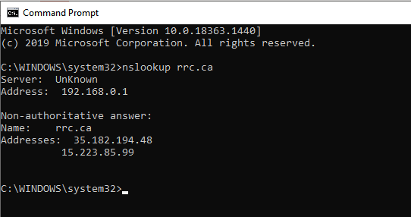
Domain name services (dns)
Type nslookup rrc.ca in command prompt and press enter

Slide 35
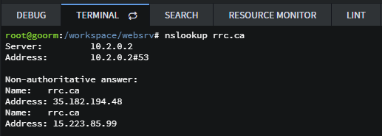
Domain name services (dns)
From your goorm container, type apt update in terminal and press enter
Type apt install dnsutils –y and press enter
Now try using nslookup rrc.ca in terminal and press enter.

Slide 36





Viewing a website
To view a web site you will use a URL (Universal Resource Locator) or an ip address
Your device has to have access to a DNS server in order to use a URL

Slide 37


Viewing a website
Whatever browser you are using, type the URL into the address bar
Google Chrome Address Bar
Firefox Address Bar

Slide 38
Firewalls
Firewalls are a set of rules on a computer or network device that determine what type of communication is allowed or denied
Rules can filter communication by port number, IP address or MAC address
These rules may be set by your organization therefore you may not have access to make changes
By default, firewalls are configured to block everything coming in (implicit deny) except the items on its exception list (items going out are unaffected)

Slide 39
Firewalls – Port forwarding
Port Forwarding allows remote devices access through your firewall to a specific IP address and port number(s) inside your LAN.
Use caution when configuring port forwarding rules as you may be exposing your device to untrusted networks (e.g. Internet).

